Slide 1
Superconducting QC Design with Qiskit Metal
A QHardware Tutorial Series
Part-5

Slide 2
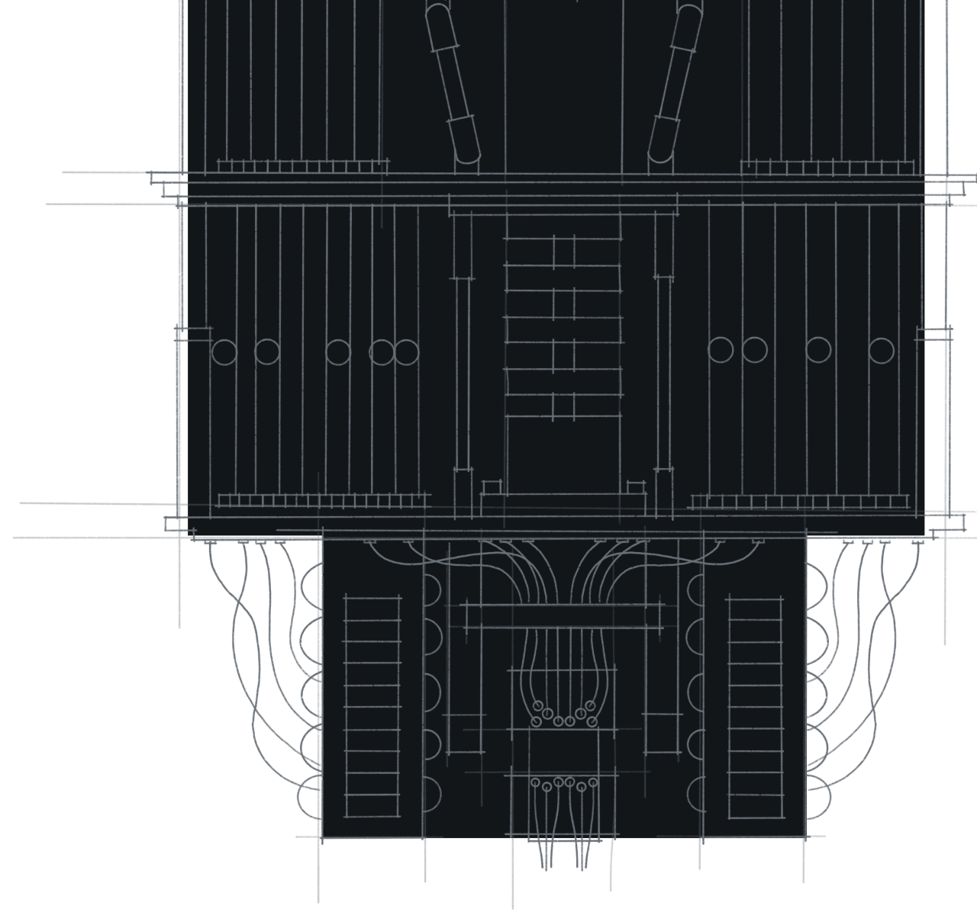
Qiskit metal
Qiskit metal is an open-source framework (and library) for the design of superconducting quantum chips and devices. It is called quantum EDA (Q-EDA) and analysis.

Slide 3
Foundation modules
Qiskit Metal consists of four foundational elements:
Quantum Device Design (QDesign): QDesign
Quantum Device Components (QComponent): Core Classes
Quantum Renderer (QRenderer): Renderer Base
Quantum Analysis (QAnalysis): Analysis Core

Slide 4
How quantum chips are designed?
Quantum Device Design with Superconducting Circuits Steps
Physical Layout
Electromagnetic Analysis
Quantum Hamiltonian Analysis
Qubit Hilbert Space

Slide 5
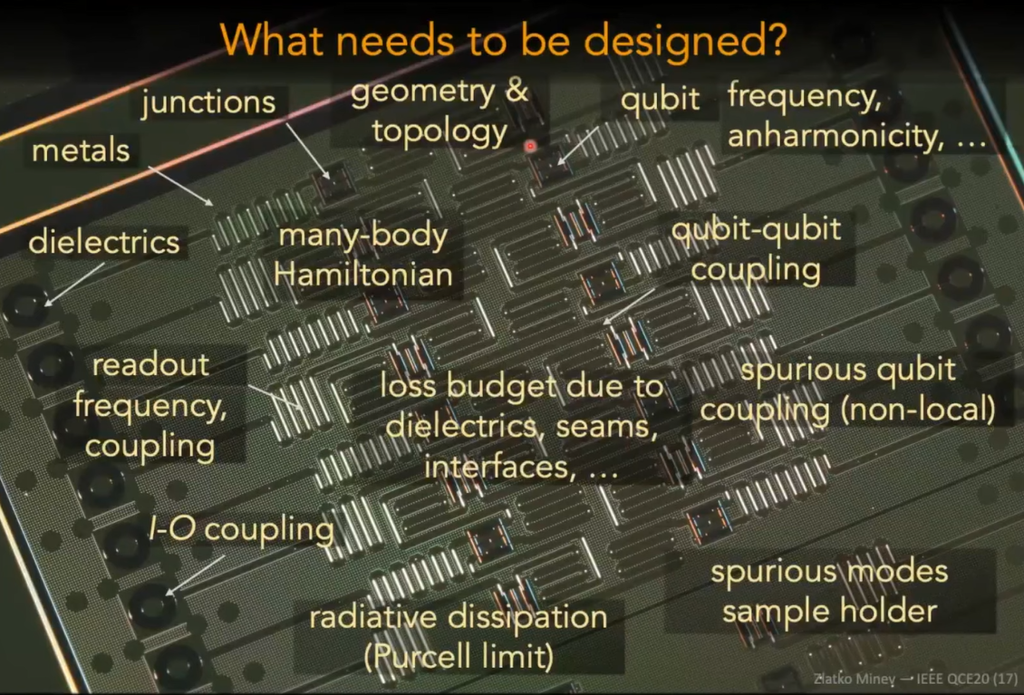
What needs to design quantum chip

Slide 6
Hardware fabrication process
For the circuit design and fabrication system, numerous steps are followed for processing to go from a lumped circuit description of an electronic design to the full layout of a circuit.
The first step that is generally followed in fabrication is BOM (Bill of Materials) confirmation (components of design).
A bill of materials or product structure is a list of the raw materials, sub-assemblies, intermediate assemblies, sub-components, and parts, and the quantities of each needed to manufacture an end product.
The second step is the coordination of data files from the bill of materials.
Then another significant step comes, which is called gerber file generation and processing.

Slide 7
Hardware fabrication process
The Gerber format is an open ASCII vector format for printed circuit board (PCB) designs.
It is a standard used by PCB industry software to describe printed circuit board images.
The next process is making a design of the circuit as per the standard.
The subsequent important step is the optimization of the entire program.
For instance, Fuji flexa is a software that is used for optimisation steps.
After positive results from the Quality Assurance (SA) side, the model will be ready for PP (pilot production).

Slide 8
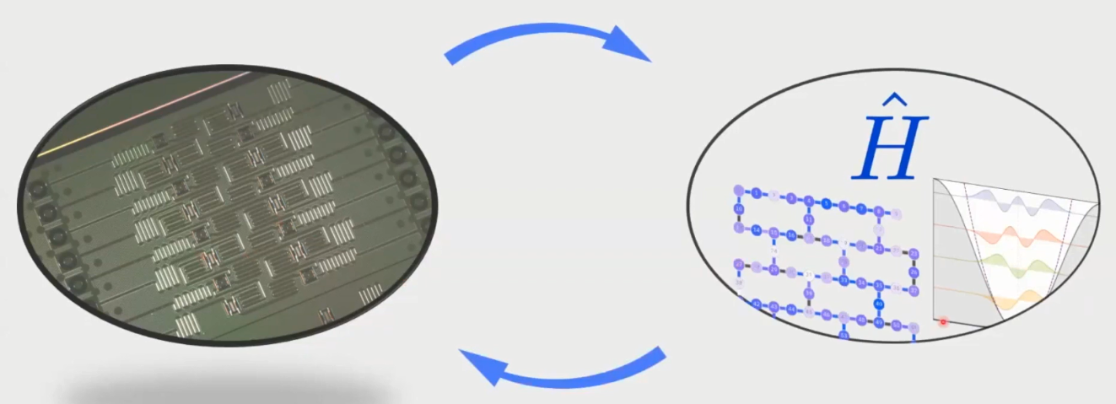
Intro to metal
Layout, analyze and optimize a four qubit quantum chip.

Slide 9
Qiskit metal using process
1. Choose a design class to instantiate.
2. Add and modify pre-built components (qubits, coplanar wave guides, etc.) from the QComponent library to your design.
3. Render to Simulate & Analyze
Current Rendering Options:
Ansys
HFSS Renderer - for high frequency simulations (eigenmode, modal, terminal)
EPR Analysis - Uses eigenmode simulation to perform energy participation ratio analysis
Q3D Renderer - for extracting equivalent circuit values of a layout, such as capacitance
LOM Analysis - Uses the capacitance matrix from Q3D to determine the parameters of a transmon qubit
4. Render for Fabrication
Current Rendering Options:
GDS

Slide 10
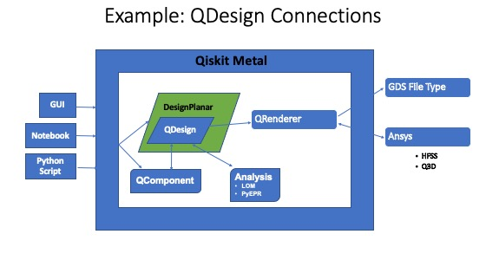
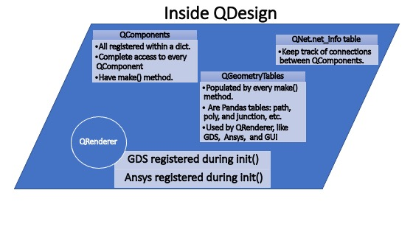
Qdesign module

Slide 11
Transmon qubit design

Slide 12
References
1. Qiskit Metal Documentation- https://qiskit.org/documentation/metal/
2. Qiskit Textbook- https://qiskit.org/learn/
3. A Quantum Engineer's Guide to Superconducting Qubits (https://arxiv.org/abs/1904.06560)
4. Quantum Computation and Quantum Information by Michael A. Nielsen and Isaac Chuang
5. Principles of Superconducting Quantum Computers by Daniel D. Stancil and Gregory T. Byrd
6. National Academies of Sciences, Engineering, and Medicine. 2019. Quantum Computing: Progress and Prospects. Washington, DC: The National Academies Press. https://doi.org/10.17226/25196.

